Slide 1
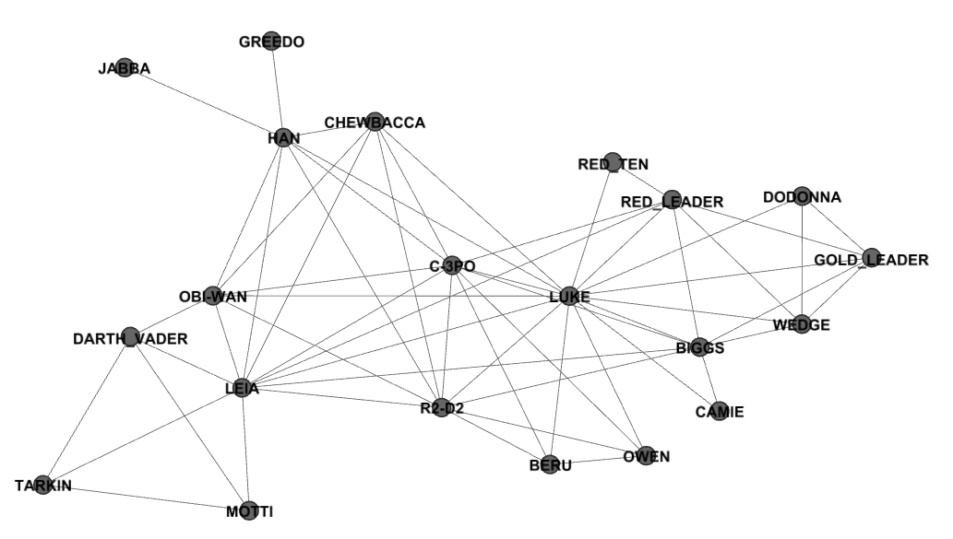
Episode IV network

Slide 2
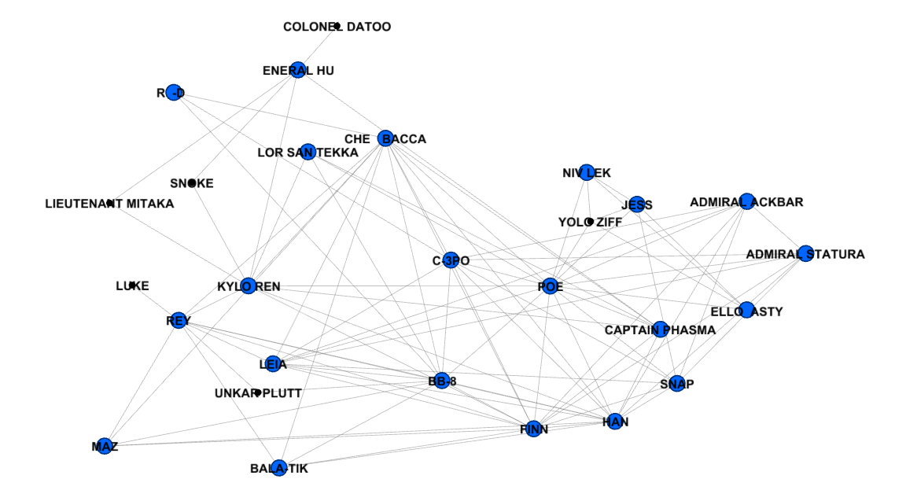
Episode VIII network

Slide 3
The shard anatomy of the networks
Force conflict
Lovable robots
Rebel forces

